Slide 1

DVB reception and distribution in buildings and hotels

Slide 2
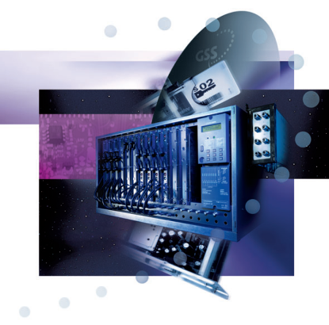
Agenda
  Alternative DVB distribution
    SAT-IF distribution versus coaxial infrastructure for DVB-T or DVB-C
  Optical SAT-IF – the better way for distribution
    What is need and how does it works
  Head-End stations for DVB reception and distribution
    Some basic information and overviews of head-end stations
  IPTV as a new player for DVB distribution
    Basics of IPTV
  GSS solution for IPTV
    Overview of what is needed
  EoC – Ethernet over Coax
    How is it possible to deliver IP-signals in old cable networks

Slide 3
Company GSS

Slide 4
GSS - Grundig SAT Systems GmbH
  15th November 1930
      Retail Shop for radios – Mr. Max Grundig
  15th May 1945
      Mr. Max Grundig open a shop with some employees in Fürth
  1971 – Conversion into Grundig AG
      In the years of 80th work more than 28,000 employees
      Grundig was the biggest employer in middle Franconia
  Since 1995 business unit „Head-end and Satellite”
  1st July 2003 the insolvency of Grundig AG
  1st May 2004 MBO of GSS from Grundig AG
    GSS - Grundig SAT Systems GmbH is established with the employees from the business unit “Head-end and Satellite”
  Today: location Nuremberg
      Quality “Made in Germany“
      Germany as economy position
      Developing, production, administration

Slide 5
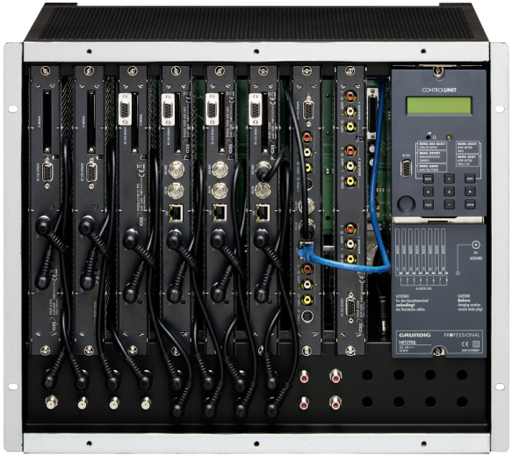
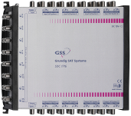

GSS today
  Core business:
    Head-end for HFC- and CATV-networks
    Multi-switch for distribution networks
  Service:
    Turn-key projects
  Location:
    90471 Nuremberg
    Beuthener Strasse 43
  Employees:
    53 Person, including 15 Person R&D
  Highlights:
    60,000 Head-ends
    700,000 Cassettes
  Slogan
    We don’t sell products, we sell solutions

Slide 6
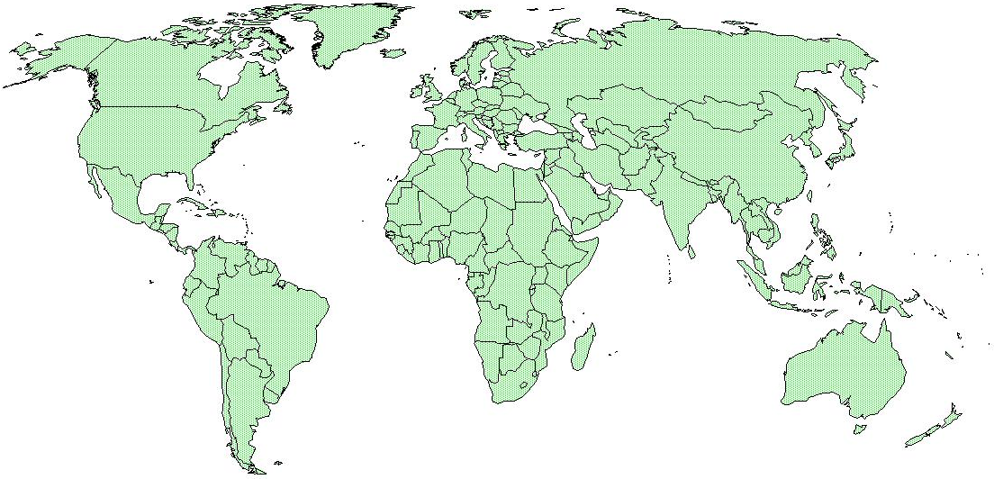
Company locations
Distributors

Slide 7
Alternative DVB distribution

Slide 8
Basics of RF- and IF-technologies

Slide 9


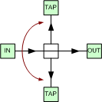
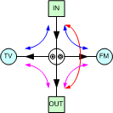

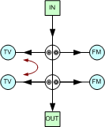
Relationship of attenuation
  Loop-through loss
    Attenuation between IN and OUT
  Tap loss / Split loss
    Attenuation between IN and TAP
  Directional loss (only taps)
    Attenuation between OUT and TAP
  Isolation
    Attenuation between the TAP‘s

Slide 10
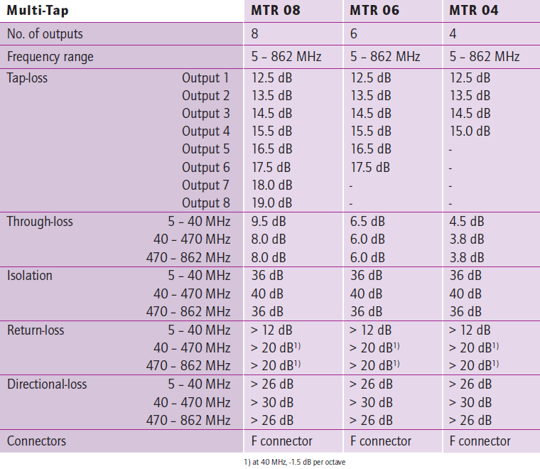
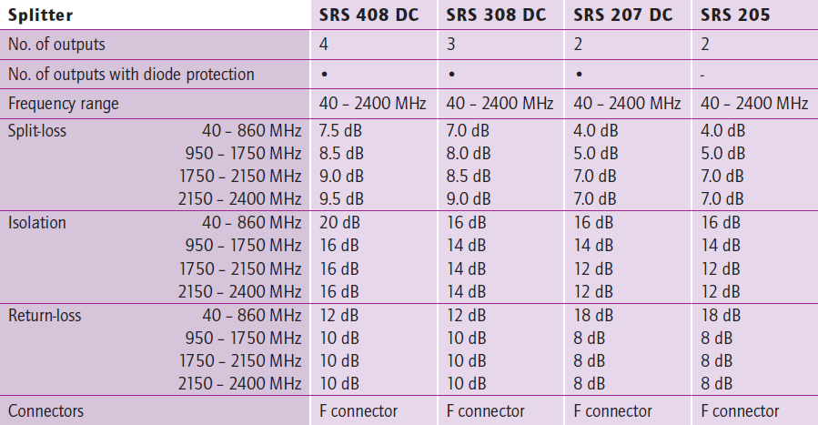

Slide 11
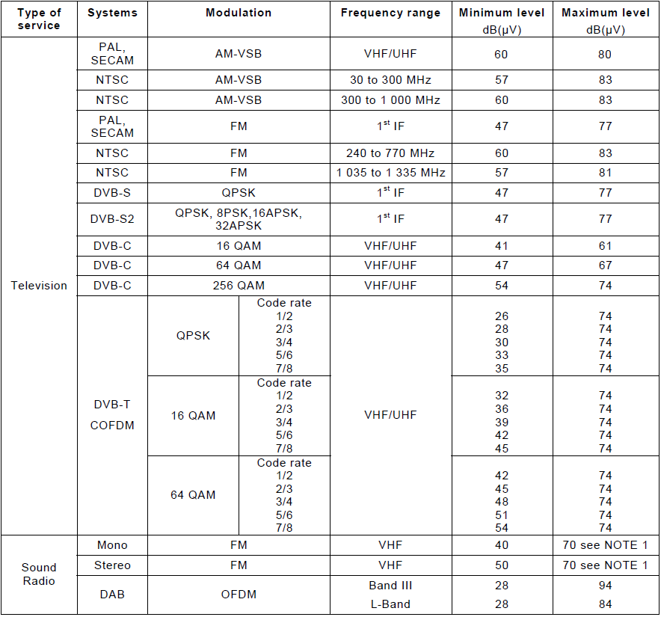
Carrier signal levels at any system outlet
  Based on International Standard IEC 60728-1
  Band I (47…68 MHz) don’t us, because it is needed for return transmission
    Upstream: 5…65 MHz
    Downstream: 80/85…862/1000 MHz
  Level difference:
    PAL 0 dB 60…80 dBµV
    FM -10 dB 50…70 dBµV
    64-QAM -13 dB 47…67 dBµV
    256-QAM -6 dB 54…74 dBµV

Slide 12
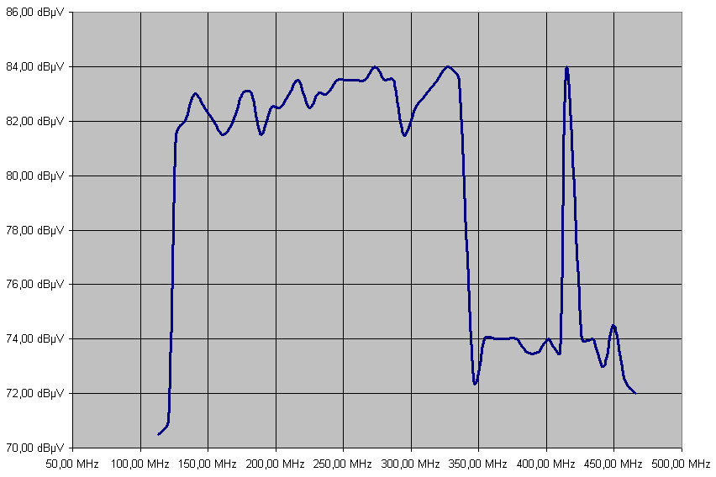
Flatness
  Flatness comes from
    Mismatch
      Bad connections,
      Units with different impedances
      Wrong equalizer for the cable
    Nonlinear components
  Result are
    Addition or subtraction of flatness (hills and valleys)
    High output level of amplifier (CTB, CSO, CXM)
    C/N get worse

Slide 13
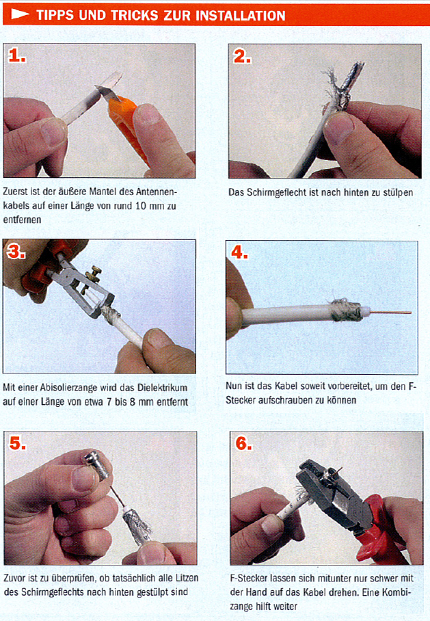
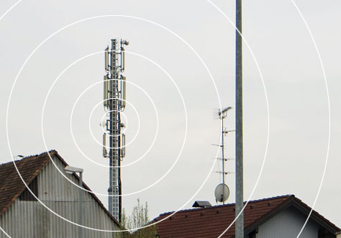
Screening
  Radiation in – from outside
  Radiation out – to outside
  Suitable connectors for correct cable
  Connect plug tighten, hand-tight is not enough
  Only use components with high screening
  Lid screws tighten
  Grounding

Slide 14
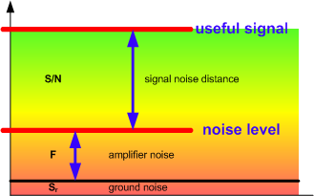
Noise - C/N | S/N
  Noise distance is
    C/N = CNR = Carrier to Noise
    S/N = SNR = Signal to Noise
    S/N = C/N + 1,5 dB (only by PAL demodulated video signal)
  The difference between wanted signal (S) and noise level (N) is the noise distance (S/N)
    The noise level (N) is the noise figure (F) and the thermal ground noise (s_{r})
    The noise figure (F) is the noise of the amplifier
  S/N = S - F - s_{r}
  N = F + s_{r}

Slide 15
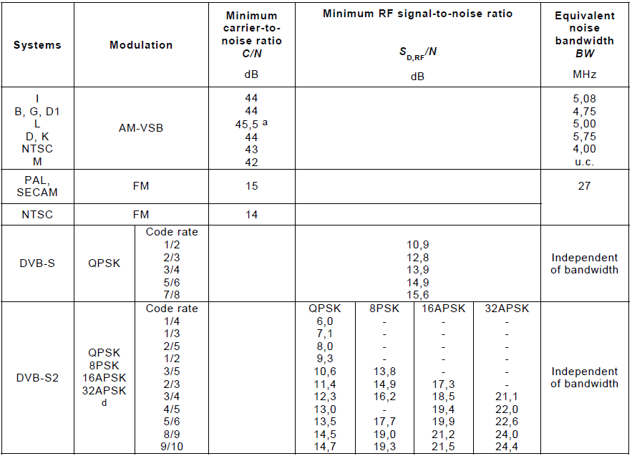
Carrier-to-noise ratios at system outlet (television)
  Based on International Standard IEC 60728-1
  Noise distance (C/N)
    CNR = L - F - V - 1,59 dB
      L = output level
      F = amplifier noise figure
      V = gain
    Example:
    CNR =100 dB -8,0 dB -40 dB -1,59 dB =50,4 dB
  Cascading amplifiers
    CNR = -10 log [10^{-(CNR1/10)} +10^{-(CNR2/10)} +...+10^{-(CNRn/10)}]
  Example:
    2 amplifiers in cascade
    CNR = -10 log [10^{-(50.4/10)} +10^{-(50.4/10)}]
    CNR = 47.4 dB

Slide 16
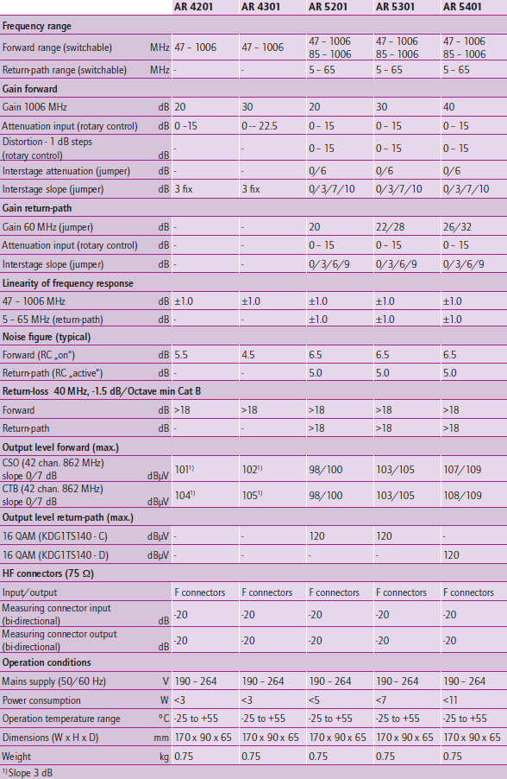
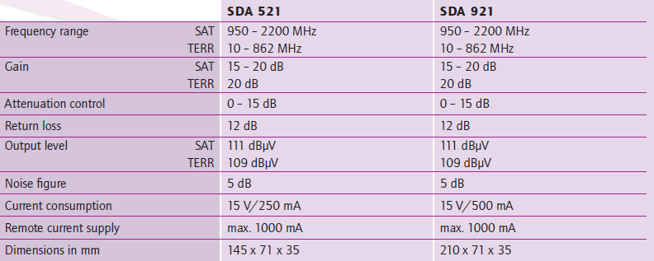

Slide 17
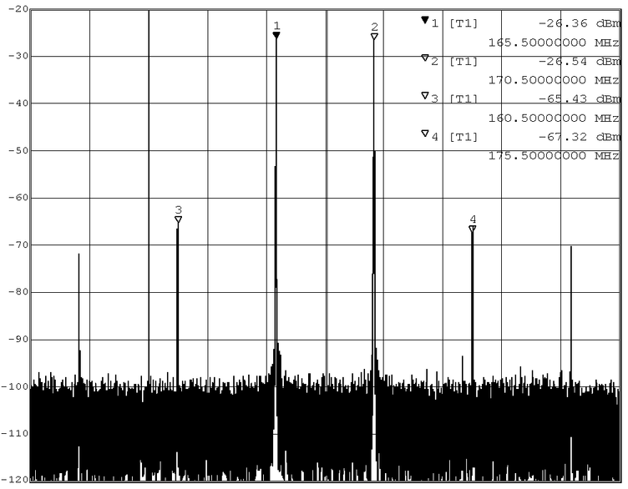
Intermodulation
  Amplifier with more or less non-linear characteristics generate when driven with multiple frequency unwanted new frequencies
  The origin of difference frequencies of the harmonics of the fundamental frequency of image-, sound- and color-carrier is called Intermodulation
  Intermodulation types
    CXM Cross modulation
    CSO Composite second order
    CTB Composite triple beat

Slide 18
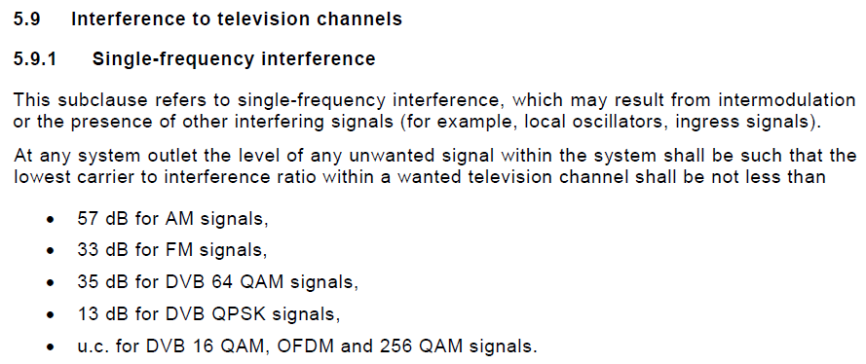
Intermodulation
  Based on International Standard IEC 60728-1
  The max. output level (CSO 42 and CTB 42) is measured with 42 carriers (CENELEC-pattern) for an interference distance of 60 dB
CSO
  Composite second order
  f₁ + f₂ | 2 x f₁ | 2 x f₂
CTB
  Composite triple beat
  2 x f₁ - f₂ | 2 x f₂ - f₁ | 2 x f₁ + f₂ | 2 x f₂ + f₁ | 3 x f₁ | 3 x f₂
CXM
  Composite cross modulation

Slide 19

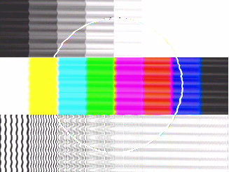
CSO
CTB

Slide 20
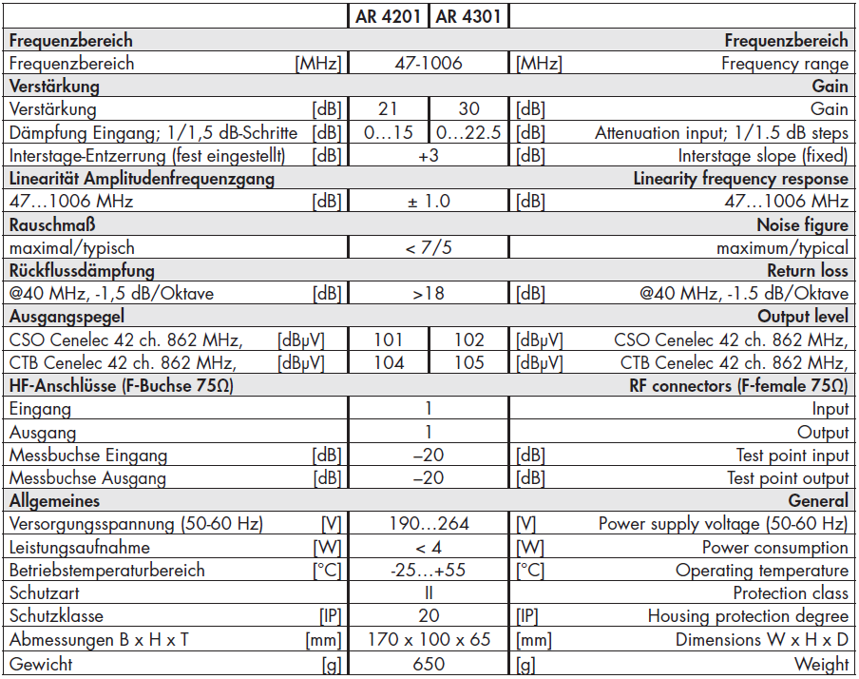
Formula
  Intermodulation (CTB, CSO)
    CTB = 60 dB + 2 x (A_{CTB} - L)
    CSO = 60 dB + A_{CSO} – L
  Example: 2 amplifiers AR 4201 in cascade
    A_{CTB} = CTB of the unit (104 dBµV)
    A_{CSO} = CSO of the unit (101 dBµV)
    L = output level (100 dBµV)
  CTB = -18 log [10^{-(CTB1/18)} +10^{-(CTB2/18)} +...+10^{-(CTBn/18)}]
    CTB = -18 log [10^{-(68/18)} +10^{-(68/18)}]
    CTB = 62.6 dB
  CSO = -10 log [10^{-(CSO1/10)} +10^{-(CSO2/10)} +...+10^{-(CSO/10)}]
    CSO = -10 log [10^{-(61/10)} +10^{-(61/10)}]
    CSO = 57.9 dB
CENELEC
Values at outlet
CNR = ≥ 44 dB
CTB = ≥ 57 dB
CSO = ≥ 57 dB
CXM = ≥ 57 dB

Slide 21
SAT-IF distribution

Slide 22
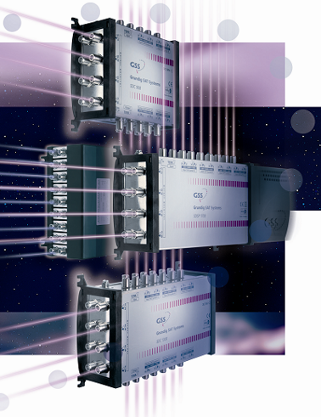
SAT-IF distribution
  Signals come direct form the LNB / dish
  The frequency range is 950…2200 MHz
  End-devices have to send control signals to the multiswitch
    Select the polarization and satellite position (DiSEqC)
  Therefore, only star distribution network are possible
  Additionally signals can be distributed in the same coaxial cable
    47…862 MHz or 5…65 / 85…862 MHz
    DVB-C (QAM)
    DVB-T (COFDM)

Slide 23
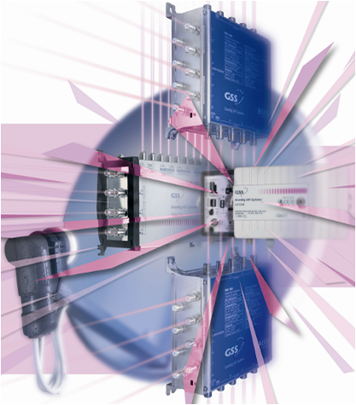
SAT-IF distribution
  Single Multiswitches
    The end devices are connected to one Multiswitch
    Family houses
  Cascadable Multiswitches
    The number of participants exceeds the possible connections of a single multiswitch
    There are several multi-switches connected in a row (cascaded)
    Multiple-dwelling units, smal areas
  Multi SAT-IF distribution
    Between the cascaded switches are amplifiers, taps and splitters
    Attenuation correction and equalising of coaxial cable

Slide 24
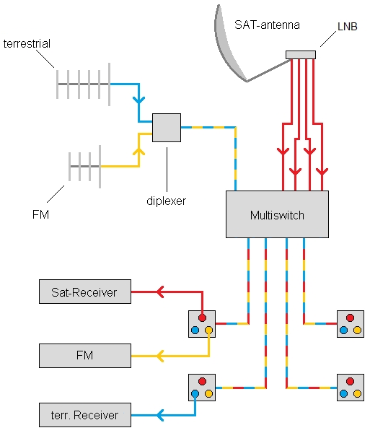
Single Multiswitches
  Single Multiswitches are designed for connection multiple end-devices to one or more of SAT-antennas
  The task is distribution the signals from LNB
  At the same time can distribute additional signals
    Terrestrial input can attenuate from 0…10 dB or switch to passive mode
    Terrestrial path is in passive mode usable for return-way
  5 / 9 / 13 / 17 inputs
  4 / 6 / 8 / 12 / 16 / 24 / 32 outputs

Slide 25
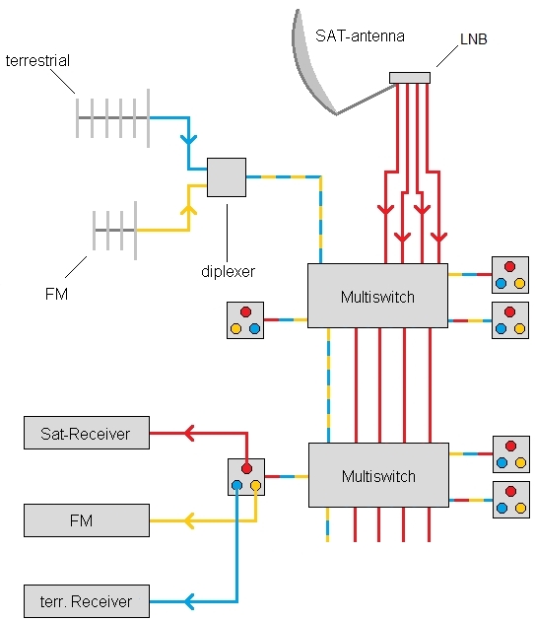
Cascadable Multiswitches
  Cascadable Multiswitches are designed for connection multiple end-devices to one or more of SAT-antennas
  The task is distribution the signals from LNB with corresponding loop-through outputs
  At the end from cascade the connections have to be locked with terminator!
    Master lines have DC-power
    F terminator with DC decoupled
  At the same time can distribute additional signals
    Terrestrial input
  5 / 9 / 13 / 17 inputs
  4 / 6 / 8 / 12 / 16 outputs

Slide 26
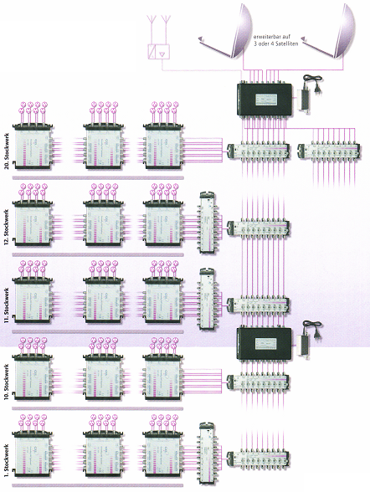
Multi SAT-IF distribution
  For large distribution systems can used the before named cascading Multiswitches
  Satellite signals are transmitted via satellite IF amplifier into the main lines
  Internal taps distributed the signals
    Floor distribution
    Other buildings
    etc.
  Additionals
    SAT-IF amplifier
    Multi-amplifier
    Multi-tap
    Multi-splitter
    Power supplies

Slide 27
Optical SAT-IF – the better way for distribution

Slide 28
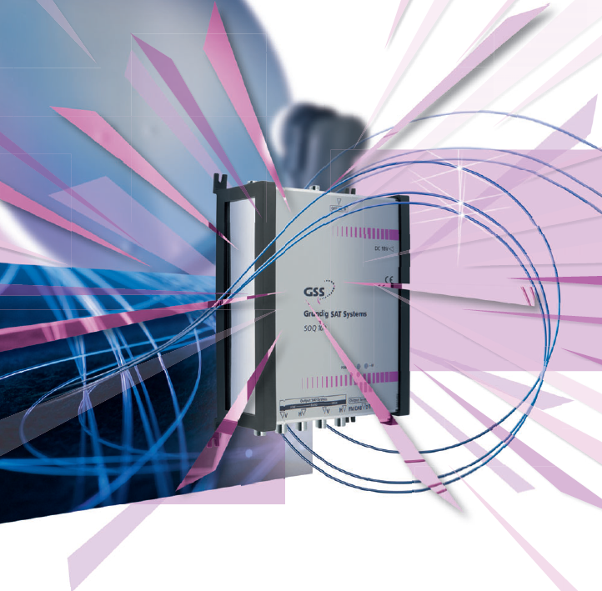
Optical SAT-IF
  Future signal distribution with excellent performance
  No problems with slope and attenuation
  Transmission over wide distances
  Split to 32 / 64 optical converters
  Support more than 1,000 units / customers
  Modern fiber-technology with signal- and quality loss
  Almost loss-free transmission (0.3 dB @ 1 km)
  Perfectly suitable for distribution of long distances resp. of several buildings
  Easy handling because of the installation of 1 fiber cable only per satellite with 4 mm diameter
  No dysfunctions regarding electromagnetic interferences
  Less installation effort
  Pre-manufactured fiber optic cables with every necessary lengths

Slide 29
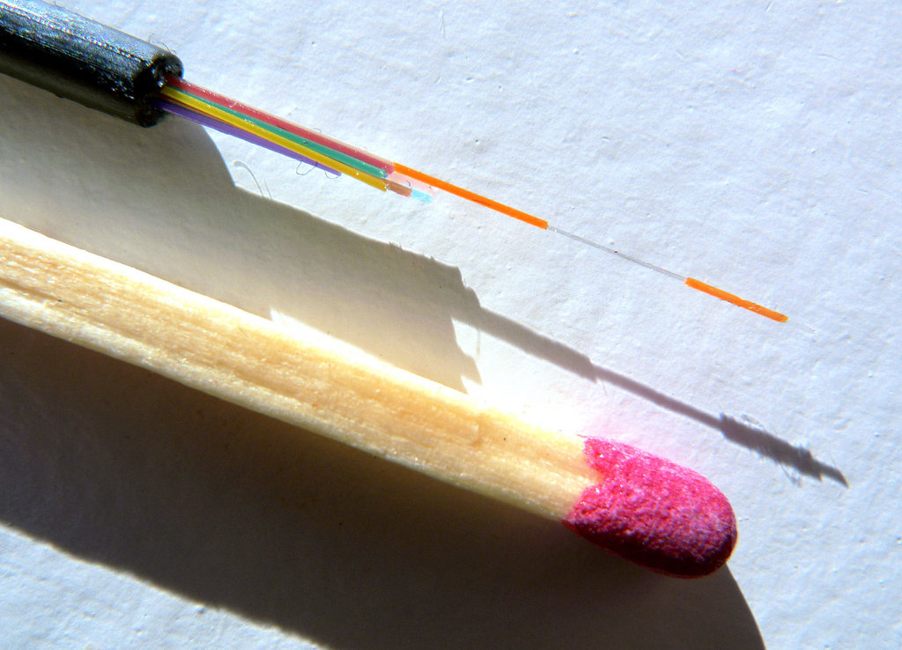

Slide 30
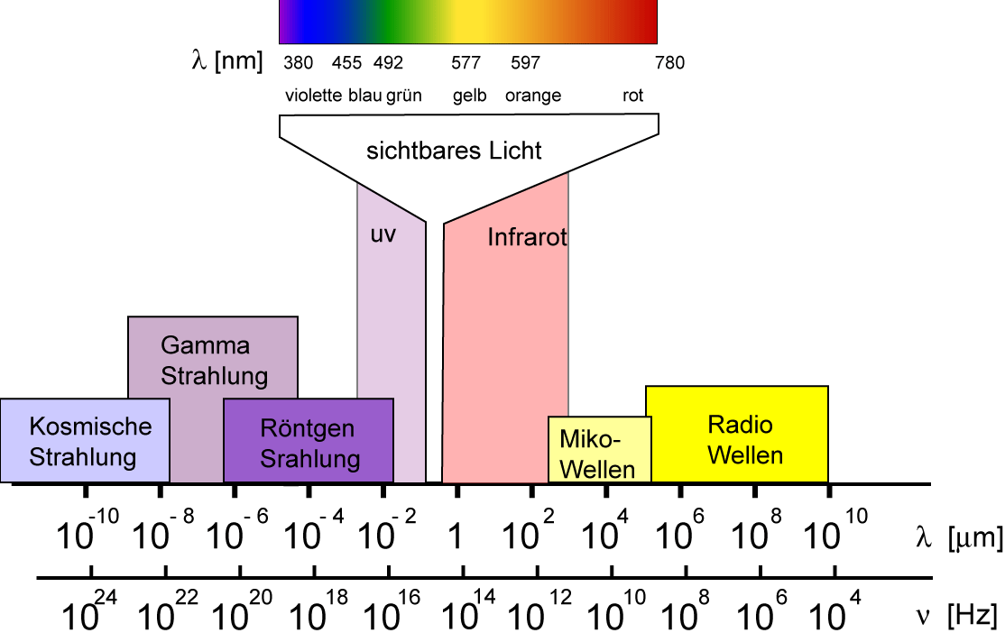
The electromagnetic spectrum
  The electromagnetic spectrum is arranged in wavelength
    Left: High-energy gamma rays
    Right: Sound waves / AC
  Light is a part of the electromagnetic spectrum
    Light describe only a small range of the electromagnetics spectrum
    Be perceived by the human eye waves in the range of about 380 ... 780 nm wavelength
  For the optical transmission is used the range 800 nm up to 1600 nm
    Frequency = Speed of light / wavelength
    Example 299.792.458 [m/s] / 1310 nm = ca. 229 THz
Source: www.didaktikonline.physik.uni-muenchen.de

Slide 31
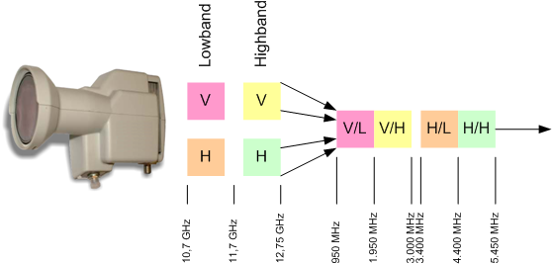
LNB with stacker and optical output
  Oscillator frequencies
    Vertical frequency: 9,7 GHz
    Horizontal frequency: 7,3 GHz
  Reception frequency: 10,7 – 12,75 GHz
  Stacking
    Frequency VL: 0,95 - 1,95 GHz
    Frequency VH: 1,95 - 3,00 GHz
    Frequency HL: 3,40 - 4,40 GHz
    Frequency HH: 4,40 - 5,45 GHz
Notes:
Q:\FIBRE\TECH_SUP\TRAINING\CFO_TECH.PPT

Slide 32
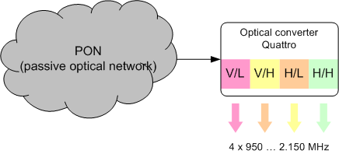
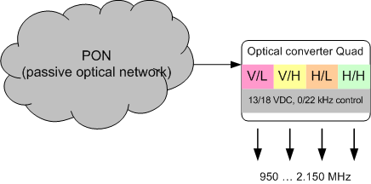
Optical converter
  Input frequency: 0,95 – 5,45 GHz
  Output frequency: 0,95 – 2,15 GHz
    Vertical frequency: 9,7 GHz
    Horizontal frequency: 7,3 GHz
  Types
    Separated by reception levels
    With integrated multiswitch
Notes:
Q:\FIBRE\TECH_SUP\TRAINING\CFO_TECH.PPT

Slide 33

Technical details
Grundig SAT Systems GmbH

Slide 34
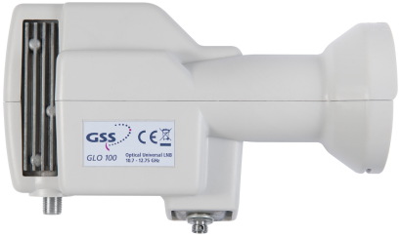
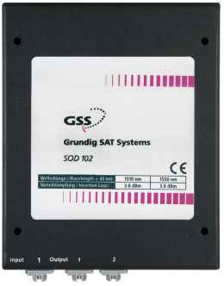
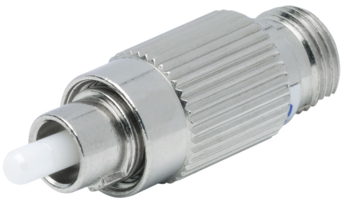
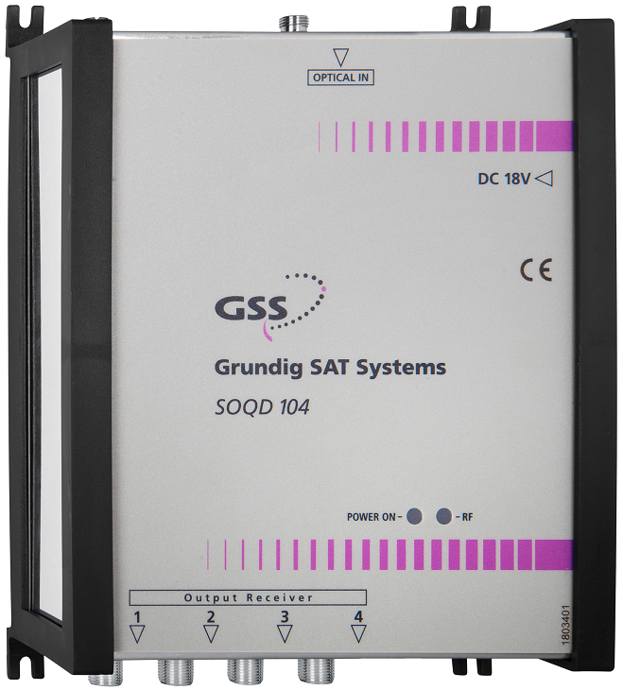
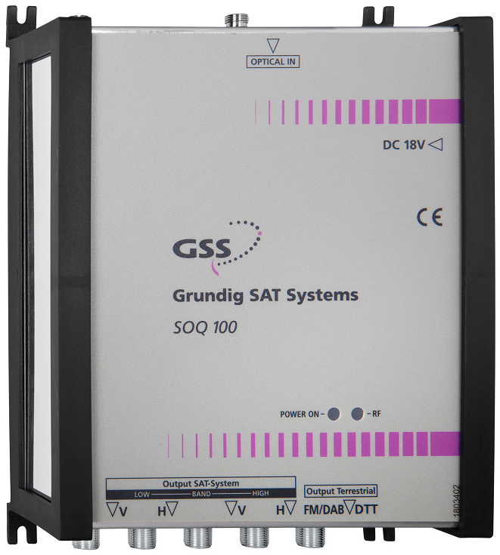
System structure
  Optical LNB
    GLO 100
    Power supply
  Optical spitter
    1:2 bis zu 1:32
    Splitters can be cascaded
  Optical converter
    SOQ 100 – all 4 ranges
    SOQD 104 – direct connection to receivers
  Optical attenuatar
    Depends from the input level

Slide 35
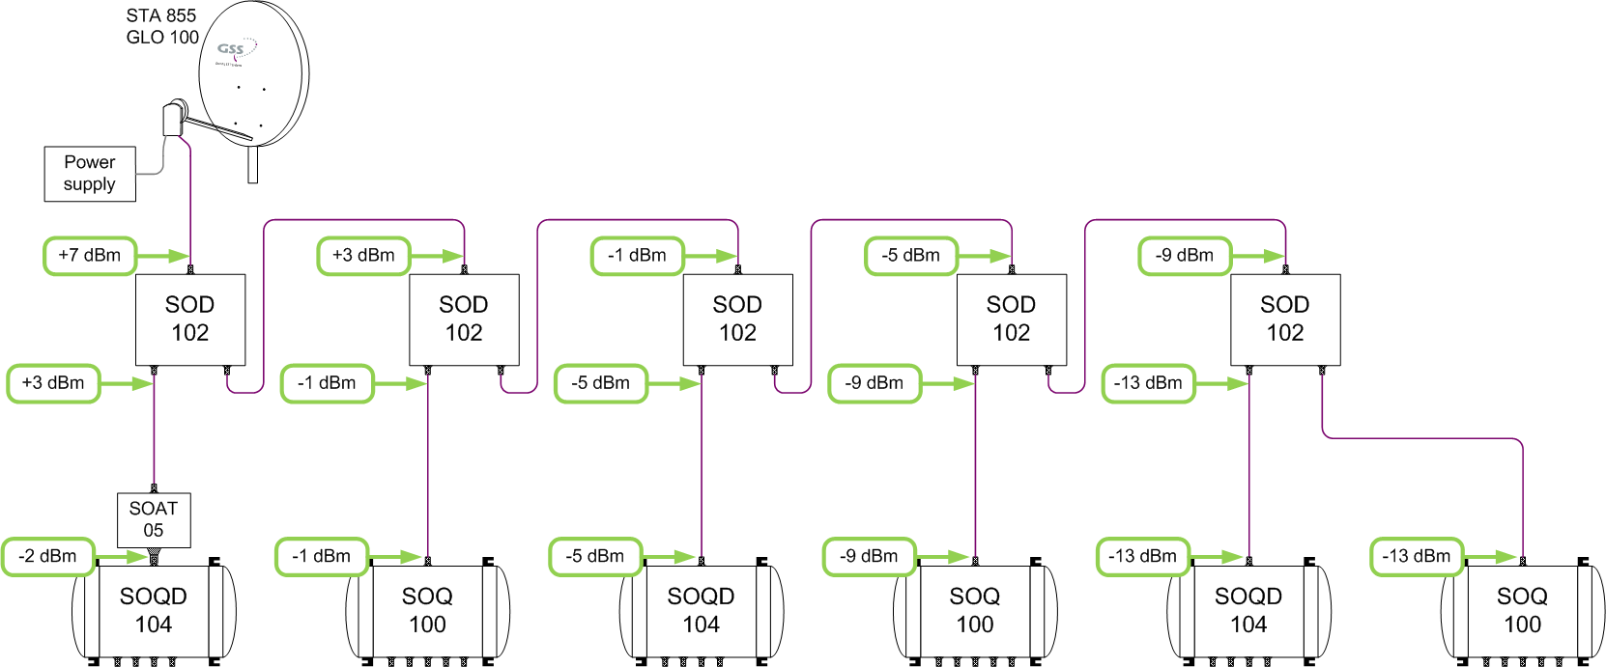
Input power between -2 and -13 dBm
Optimal, > -15 dBm

Slide 36
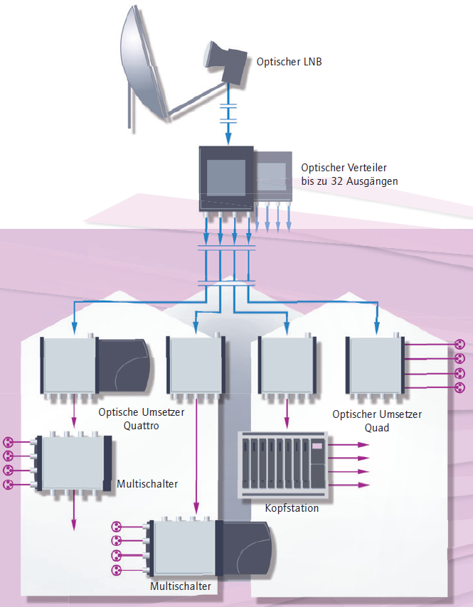
System budget
  Optical LNB
    Output power +7 dBm
  Optical converter
    Min. input level -15 dBm
  System budget
    Maximum attenuation 22 dB
Input power > 0 dBm
Overload the optical converter

Slide 37
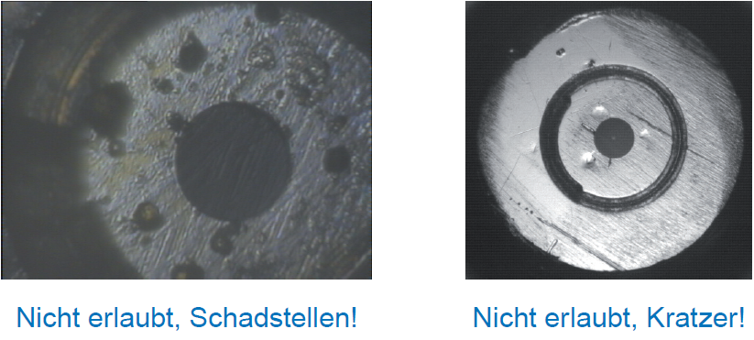
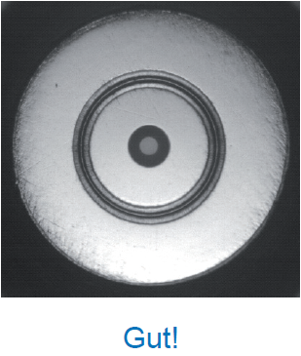
Cleanness of optical connectors
  Cleanliness is a prerequisite for fault-free optical transmission systems
  Effects:
    Pure quality for analogue signals
    Increase of bit error-rate
    Reduction of optical power (attenuation)
    Damage the other connector
  Core diameter is only 9 µm
    A human hair has a diameter of 50-100 µm
No
No
Yes

Slide 38
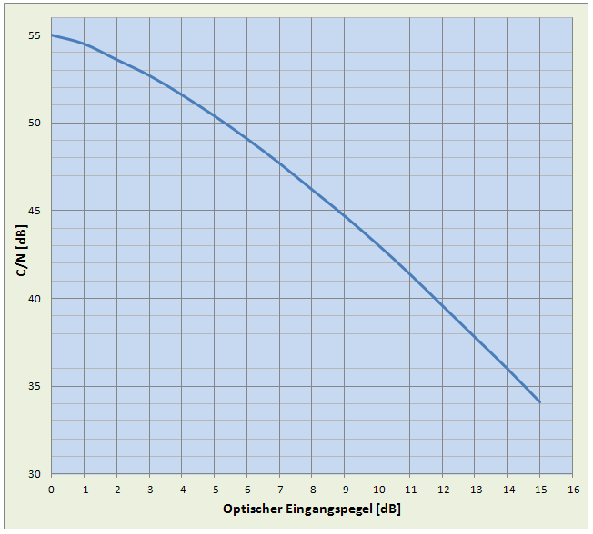
Signal noise ratio
  Picture show the typically CNR in dependence from optical input level of the optical converter
    Max. input level = 0 dBm ≙ 55 dB C/N
    Min. input level = -15 dBm ≙ 34 dB C/N
  In addition to CNR play the intermodulation a more important role
    Manufacturers are no known values​​!
    Therefore, it is not advisable from a multi-channel assignment
    Only individual channels, such as terrestrial DVB-T or FM
    Definitely not a head-end sum signal
  Terrestrial input level
    67…97 dBµV
  Recommendation:
    70 dBµV
    max 6 digital multiplex carrier

Slide 39
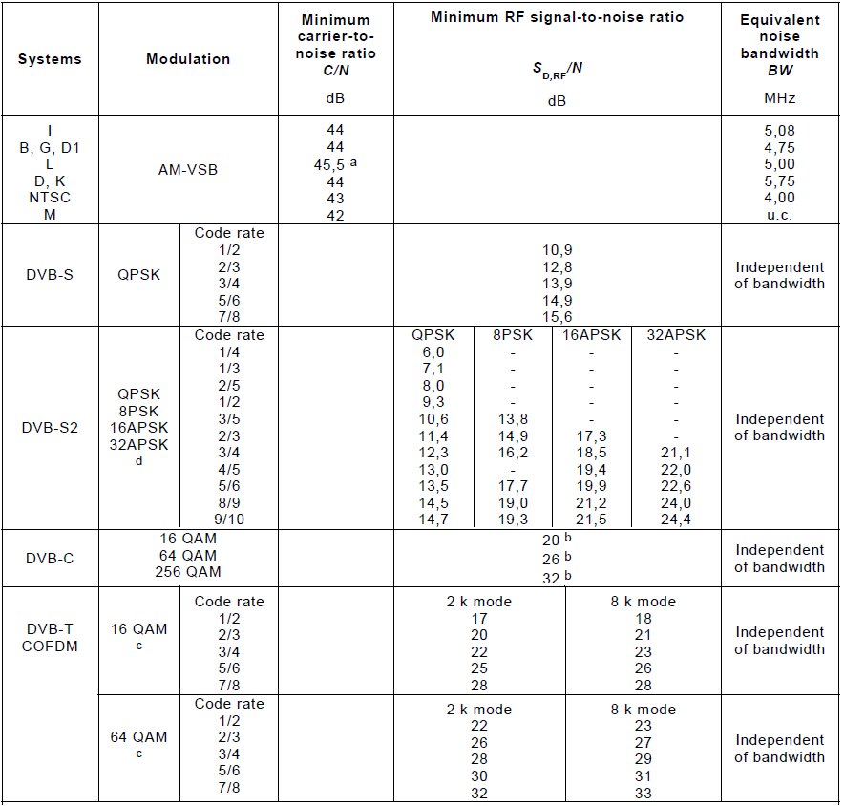
Signal noise ratio
  Picture shows the minimum CNR values for the customer
  IEC 60728-1
  In memory
    Max. input level = 0 dBm ≙ 55 dB C/N
    Min. input level = -15 dBm ≙ 34 dB C/N
  Example:
    DVB-S | QPSK | CR = 2/3 ≙ 12,8 dB
    DVB-S2 | 8-PSK | CR = 9/10 ≙ 19,3 dB
    DVB-C | 64-QAM ≙ 26,0 dB
    DVB-C | 256-QAM ≙ 32,0 dB
    DVB-T terrestrial ≙ 22,0 dB
    DVB-T | 64-QAM | CR = 7/8 ≙ 32,0 dB
    PAL B/G (BK) ≙ 44,0 dB

Slide 40
Application examples
Grundig SAT Systems GmbH

Slide 41
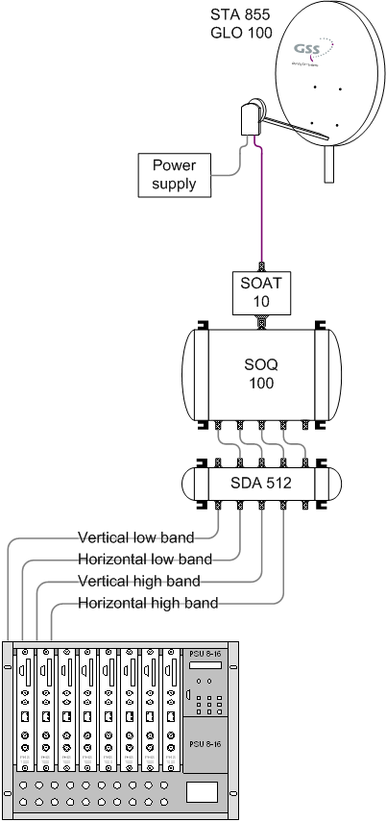
Feed to head-ends
  Satellite dish with optical LNB
    GLO 100
  Attenuator
    SOAT 10 with 10 dB attenuation
  Optical converter Quattro
    SOQ 100
    Converting the optical input signal to 4 coaxial output signals
    All 4 satellite ranges
  Head-end station
  Advantage:
    No quality loss
    No slope
    No amplifier in cascade
    Long distance
    Electrical isolation
    Easy installation

Slide 42
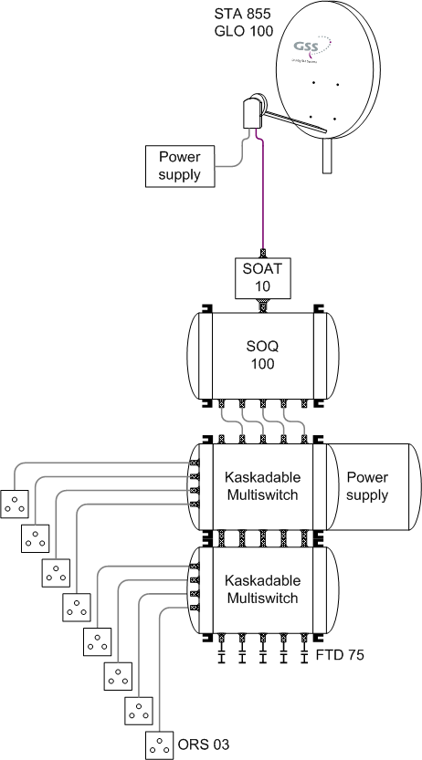
Feed to multiswitches
  Satellite dish with optical LNB
    GLO 100
  Attenuator
    SOAT 10 with 10 dB attenuation
  Optical converter Quattro
    SOQ 100
    Converting the optical input signal to 4 coaxial output signals
    All 4 satellite ranges
  Multiswitch
  Advantage:
    No quality loss
    No slope
    No amplifier in cascade
    Long distance
    Electrical isolation
    Easy installation

Slide 43
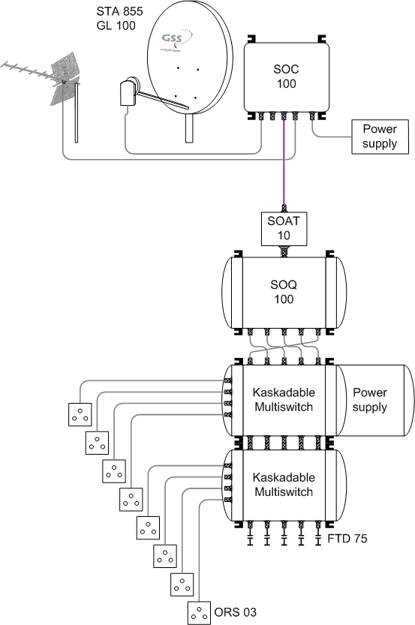
SAT-IF and terrestrial signals
  Satellite dish with optical LNB
    GL 100
  RF-LWL converter
    SOC 100
  Terrestrial antenna
  Attenuator
    SOAT 10 with 10 dB attenuation
  Optical converter
    Quattro – SOQ 100
    Quad – SOQD 104
    Converting the optical input signal to 4 coaxial signals
  Multiswitch, head-end, GSS.box
  Additional terrestrial signals
    FM
    DVB-T

Slide 44
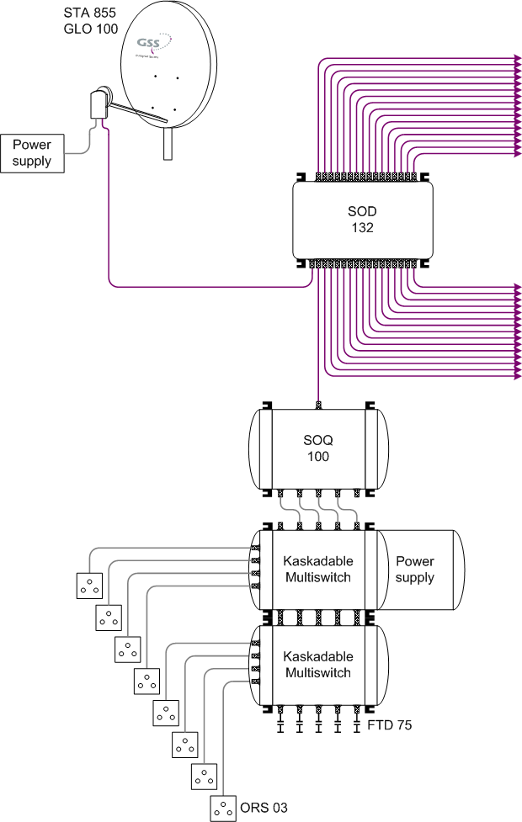
Multi distribution up to 32-ways
  Satellite dish with optical LNB
    GLO 100 or GLOS 100
  Optical splitter
    SOD 102 … SOD 132
  Optical converter
    Quattro – SOQ 100
    Quad - SOQD 100
    Converting the optical input signal to 4 coaxial output signals
  Multiswitch, head-end, GSS.box
  GLOS 100 with additional terrestrial signals
    FM
    DVB-T

Slide 45
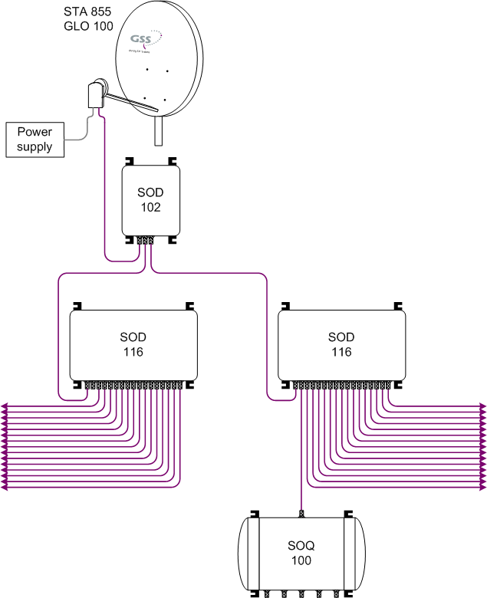
Multi distribution
  Satellite dish with optical LNB
    GLO 100 or GLOS 100
  Cascading of optical splitter
    SOD 102 … SOD 132
    Up to 32 optical outputs (depends on the attenuation)
  Optical converter
    Quattro – SOQ 100
    Quad - SOQD 100
    Converting the optical input signal to 4 coaxial output signals
  Multiswitch, head-end, GSS.box
  GLOS 100 with additional terrestrial signals
    FM
    DVB-T

Slide 46
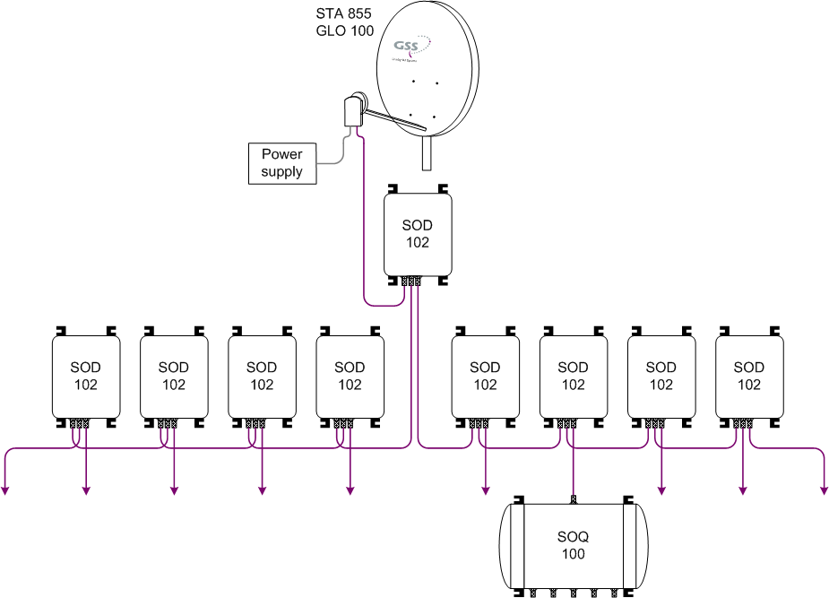
Multi distribution
  Satellite dish with optical LNB
    GLO 100 or GLOS 100
  Cascading of optical splitter
    SOD 102 … SOD 132
    Up to 32 optical outputs (depends on the attenuation)
  Optical converter
    Quattro – SOQ 100
    Quad - SOQD 100
    Converting the optical input signal to 4 coaxial output signals
  Multiswitch, head-end, GSS.box
  GLOS 100 with additional terrestrial signals
    FM
    DVB-T

Slide 47
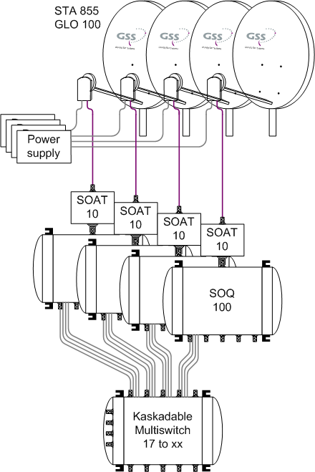
Several satellite positions
  Each sattelite-system get an own fiber
  Satellite dish with optical LNB
    GLO 100 or GLOS 100
  Cascading of optical splitter
    SOD 102 … SOD 132
    Up to 32 optical outputs (depends on the attenuation)
  Optical converter
    Quattro – SOQ 100
    Quad - SOQD 100
    Converting the optical input signal to 4 coaxial output signals
  Multiswitch, head-end, GSS.box
  GLOS 100 with additional terrestrial signals
    FM
    DVB-T

Slide 48






Conclusion
  Easy installation
    Quick and easy installation
    Only one 4 mm Glasfibercable per satellite
    All 4 SAT-IF ranges in 1 fiber
  Transmission over wide distances
    Split to 32 / 64 optical converters
    Support more than 1,000 units / customers
  Modern fiber-technology with signal- and quality-loss
  No dysfunctions regarding electromagnetic interferences
  Pre-manufactured fiber optic cables with every necessary lengths
  For all applications
    Head-ends
    Multiswitches
    GSS.box

Slide 49
Head-End stations for DVB reception and distribution

Slide 50


History of digital television
  1993
    Agreement for digital transmission via satellite and cable
  28. July 1996
    Start of digital transmission in Germany via DVB-S / DVB-C
  4. August 2003
    DVB-T, terrestrial digital transmission in Berlin, Germany
  March 2005
    New standard DVB-S2 and start of HDTV transmission
  2010 - 3D television
    Development of DVB-T2, DVB-C2
  2012 - Olympic games in 3D
  2013 - Discussion over 4 k
    First TV-sets, new codec H.265 (HEVC)
  2014 - Broadcast via 4 k for FIFA World Cup
  2016 - Olympic games via 8k

Slide 51






Head-Ends
  PROFESSIONAL-line for cable operators (HFC-network)
  STANDARD-line for medium size CATV-networks
  BASIC-line for SMATV
  With main functions:
    Remote configuration, headend control over satellite
    Multiplexing
    Big networks, long cascade, high CNR up to 60 dB
    IPTV, IP-streaming, IP-recording
    Processing of digital and analogue signals
    Encoder for: AV, HDMI
    COFDM, QAM, PAL, FM
    DVB-S, DVB-S2, DVB-T, DVB-T2, DVB-C, DVB-C2
    SDTV, HDTV (MPEG-2, MPEG-4)
  Latest cassette-technology can be operated in the first-generation headend
    Long-term durability

Slide 52






STC 1200 / PSU 12 – with 12 slots
  Adjacent channel head-end for medium CATV-networks and professional networks
  Slots for 12 double cassettes
    Up to 24 analogue programs
    Up to 48 digital transponders
  Electronically software supported level adjustment
  Universal platform for all DVB content
    IP, ASI, PAL, FM, DVB-C, DVB-T, DVB-S(2)
  3 integrated SAT-IF splitter, RF combiner, power supply and control unit
  Output channel range
    47…862 MHz
  Passive cooling, no fans
148 W bei 12 x HDM 2380
137 W bei 12 x HDTV 1000 ASI LAN

Slide 53


STC 816 / PSU 8-16 – with 8 slots
  Same futures as STC 1200 / PSU 12
  8 slots for double cassettes
    Up to 16 analogue programs
    Up to 32 digital transponders
  Electronically software supported level adjustment
  2 integrated SAT-IF splitter, RF combiner, power supply and control unit
  Passive cooling, no fans
97 W bei 8 x HDM 2380
90 W bei 8 x HDTV 1000 ASI LAN

Slide 54



STC 160 – BASIC line
  Designed for receiving and convert from analogue TV, digital TV and FM programs
  Quadruple modulation concept
    Conversion up to 16 analogue programs
    Up to 32 digital transponders
  Electronically software supported level adjustment via control unit
  Wide output channel range:
    C 02 …C 69
    S 03 … S 41
  Pluggable LNB powering
  High output level up to 102 dBµV
  Wall installation or 19“-racks
  Integrated control unit
  Integrated power supply
99 W bei 16x SAT in PAL
83 W bei 16x QAM HDTV

Slide 55

PST 19-1
  Installation-frame for one cassette
  19”, 1 HE
  External plug power-supply
  Programming with external BE-Remote
    BE-Remote can remove after programming
  Stand alone after programming
12 W bei 1 x HDM 2380
11 W bei 1 x HDTV 1000 ASI LAN

Slide 56


RCU 1 – for Profi- und Standard-line
  SNMP management interface (LAN)
  Connection via LAN-router or Internet
  Up to two stations can be configured and remote controlled with software PSW 1000
  Configuration can be read and transferred to other stations
  NIT can be read and edit
  NIT can be create for one and more stations
    The frequencies of other company QAM-modules can be added
  DVB-channels can be allocated a Logical Channel Number (LCN)
  Two connections for monitoring cassette or second headend station

Slide 57



RCU 160 with RCA 162 – for Basic-line
  Management interface unit
  Connection via LAN-router or Internet
  Up to two stations can be configured and remote controlled with software PSW 160
    RCU 160 – main station
    RCA 162 – second station
  Configuration can be read and transferred to other stations
  NIT can be read and edit
  NIT can be create for one and more stations
    The frequencies of other company QAM-modules can be adde
  DVB-C channels can be allocated a Logical Channel Number (LCN)

Slide 58



PSW 160
  Adjustment of STC 160 and modules
    Read and store
    Transmit to other stations or modules
  NIT reading und transmitting
    Insert of external data from other head-end stations into NIT
  LCN

Slide 59



PSW 1000
  Software for Standard- and Profi-line
    Read and store
    Transmit to other stations or modules
  NIT reading und transmitting
    Insert of external data from other head-end stations into NIT
  LCN
  Delete of single PID‘s (only with PSW 1000)
  Change from SID
  Log-book

Slide 60

Input signals
  Analogues FM
  Analogue sources (Audio / Video)
  HDMI (have to encode)
  DVB-S / DVB-S2
  DVB-S2 16/32APSK
  DVB-T / DVB-T2
  DVB-C / DVB-C2
  DVB-ASI
  DVB-IP

Slide 61

Output signals
  Analogues HF-Signal (PAL)
  Analogues FM
  DVB-C / DVB-C2
  DVB-T / DVB-T2
  DVB-ASI
  DVB-IP

Slide 62






Conversion from digital to analogue
  Old TV-sets can’t receive without STB digital signals
  Different cassettes with 2 or 4 input tuners
    Convert 2 or 4 analogue programs
  Support MPEG-2
    MPEG-4, HD with special types
  Mono- or Stereo modulator
  VPS, teletext, WSS
    Test lines adjustable
  Movable black bar
    Size and position adjustable, need for deactivation of running news
  Fullband-modulator
  Electronically software supported level adjustment
  No electrolytic capacitor → long life expectancy
  Available in different versions

Slide 63




Conversion from digital to digital
  Modulation adaption
    HDTV, AC3 sound, EPG, different languages etc.
  Different cassettes with 2 or 4 input tuners
    2 or 4 digital transponder (one or programs)
  CI-slot
  TPS-module for program deleting (data-rate adaption
  Digital modulators
    DVB-C (QAM): 4-, 16-, 32-, 64-, 128-, 256-QAM
    DVB-T (COFDM) :QPSK, 16-QAM, 64-QAM, 2k, 4k, 8k
  NIT, Network Information Table
  LCN (only with PSW 1000) ,Logical Channel Numbering
    Program sorting by network operator
  Operator-ID adjustable
  Electronically software supported level adjustment
  No electrolytic capacitor → long life expectancy

Slide 64




DVB-C/C2/T/T2 → DVB-C/T
  For DVB-C2/T2 is needed a new TV-set or new STB
  HD2CT 860 C | HD2CT 800 C | PCT2Q 8000
    2 inputs, 2 tuners | DVB-C/C2/T/T2 → DVB-C
    2x CI-slots
  HD2CT 860 T | HD2CT 800 T | PCT2T 8000
    2 inputs, 2 tuners | DVB-C/C2/T/T2 → DVB-T
    2x CI-slots
  NIT, Network Information Table
  LCN (only with PSW 1000) ,Logical Channel Numbering
    Program sorting by network operator
  Operator-ID adjustable
  Partly with automatic adjacent output channel modulators
  Electronically software supported level adjustment
  No electrolytic capacitor → long life expectancy

Slide 65






Encoder for SD
HDE 164 | HDE 166 | HDE 210 | PADE 7006
  Twin or quad encoder cassette
    convert 2 or 4 different analogue AV signals to one MPEG transport stream
  Supports the format D1 (720 x 576 Pixel)
  CVBS input
  Data rate from 2 Mbit/s up to 15 Mbit/s, incl. 16-bit stereo sound
  Audio encoder according to MPEG1 Layer II
    Audio bit rats (192, 256, 320, 384 kbit/s)
    Audio modes: stereo, joint stereo, dual, mono
    Sampling rate 48 kHz
  ASI interface, cascadable, multiplexing
  IP interface

Slide 66


HD-Encoder
HDE 400 | PADE 4000
  Single encoder cassette, MPEG-4
    convert one analogue source to digital
    FBAS (SD)
    YPbPr (SD/HD)
    HDMI (HD)
  Encoder with MPEG-4
    HDMI (HD)
    YPbPr (SD/HD)
    FBAS (SD)
    1920 x 1080p 50/60 Hz (Recommondation: 1080i)
    PAL / NTSC / SECAM
    Audio via Cinch or optical SPDIF-interface
    Data-rate from 1.5 Mbit/s up to 31 Mbit/s
  Output as:
    DVB-ASI, cascading with other cassettes
    DVB-IP
    Internal modulator al DVB-C or DVB-T

Slide 67


Slide 68


MultiDigital® plattform with Multiplexing and IP-streaming
  Double cassettes
    IN: DVB-S (S2), DVB-C, DVB-T, DVB-ASI, DVB-IP
    OUT: DVB-C, DVB-T, DVB-ASI, DVB-IP
    IP out/in: SPTS and MPTS
  CI slot
  DVB-ASI
    Interface for multiplexing
    Add and delete programs
  IP/Ethernet interface
  Transport Stream Processing
  UDP/IP or RTP/IP protocol
  Multicast or Unicast
  Supports MPEG-2 and MPEG-4
    SD and HD
  Only available for STANDARD- and PROFI-LINE

Slide 69


MultiDigital® platform with Multiplexing and IP-streaming
  DVB-S/S2 → DVB-C/T with ASI
  DVB-C/T → DVB-C/T with ASI
  DVB-S/S2 → DVB-IP
  DVB-C/T → DVB-IP
  DVB-IP → DVB-C/T
  Twin-transmodulator for digital satellite receiving
    2 inputs, 2 tuners
  2 digital modulators, DVB-C (QAM) or DVB-T (COFDM)
  DVB-ASI interface for multiplexing
  NIT, Network Information Table
  LCN (only with PSW 1000) ,Logical Channel Numbering
    Program sorting by network operator
  Operator-ID adjustable
  No electrolytic capacitors

Slide 70
Multiplexing
  DVB signal from tuner
    Receiving
    Descrambling
    Demultiplexing
    Delete programs
  DVB signal from ASI
    ASI input to output
    ASI to the TPS module
  Transport stream processing (TPS-module)
    Filter (Program selection)
    Stuffing
    NIT generating
    Operator ID (CAT) programming
  Multiplexer
  RF output
    Modulators (COFDM, QAM)
    ASI

Slide 71


Multiplexing example: DVB-S(2) to COFDM
  2 SAT-transponder to 3 COFDM-channels
  New multiplexes are needed
    2 transponder 2 x 38 Mbit/s = 76 Mbit/s
    2 cassettes, 4 inputs
    3 COFDM-channels 3 x 31 Mbit/s = 93 Mbit/s
    ca. 82% capacity for each output
  Top transponder
    38 Mbit/s | 6 programs | Ø 6,4 Mbit/s
    4 x 6,4 Mbit/s = 25,6 Mbit/s
  Below transponder
    38 Mbit/s | 10 programs | Ø 3,8 Mbit/s
    7 x 3,8 Mbit/s = 26,6 Mbit/s
  Middle transponder
    2 x 6,4 Mbit/s = 12,8 Mbit/s
    3 x 3,8 Mbit/s = 11,4 Mbit/s
    Sum = 24,2 Mbit/s
Source: www.lyngsat.com

Slide 72
Multiplexing: 2x DVB-S to 3x COFDM

Slide 73
IPTV as a new player for DVB distribution

Slide 74

IPTV for modern communication
  Definition, source: Wikipedia
    Internet Protocol television (IPTV) is a system through which television services are delivered using the Internet protocol, instead of being delivered through traditional terrestrial, satellite signal, and cable television formats.
  Advantages
    No CNR / CTB / CSO / level / attenuation etc.
    Addressable
      Personalized TV-content for any customer necessities
      PayTV / VoD, Billing for services
    Personalized greetings / News / Information
      Guest releases
    Comfort functions
      Messages, alarm messages, wake-up
    TV-content from different sources, convertible to IPTV
    No limit from content
    Same quality as digital TV (DVB-S, DVB-T, DVB-C)

Slide 75
Broadcast - Multicast - Unicast

Slide 76
Transmission for IP
  IP-transmission is every time serial
    Packets are sent one after one
    Each destination device need a buffer
  Star network can’t help
    Ethernet is a serial protocol
    A switch can handle only one packet
  Network devices should be very fast and a big buffer

Slide 77

Broadcast (one to all)
  Broadcast transmission correspond to a broadcast from one point to all
  Typical broadcast applications are radio and TV
    From one source to all receivers
    Nobody know who is connected
  In IP networks a broadcast is a message to all devices
  All routers forward this message

Slide 78
Unicast (one to one)
  Unicast is a kind of connection where the source is connected with one receiver
  Unicast said nothing about the operation direction. It can be unidirectional or bidirectional
  To communication partners communicates directly
  Example:
    Telephony
    VoD - call of individual services

Slide 79
Multicast (one to many)
  Multicast is used for transmission from one source to many receivers in one define group
  Multicast is a connection from one to many
  Advantage of multicasting is that while messages of one address can transmit to multiple subscriber or user groups
    IPTV
    Audio- and video transmission

Slide 80
IGMP
  The Internet Group Management Protocol (IGMP) is a communications protocol used to manage the membership of Internet Protocol multicast groups
    IGMP have the possibility of manage dynamic groups
      Group “Red”
      Group “Green“
      Group “…“
  Isn’t IGMP available, then all data's will be send to all ports
  Administration isn’t in transmit source, it is in the
  router => layer-3 switch
  IGMP has the function that one station (IP Set-Top-Box) inform the router that they will receive multicast packets of a define multicast group

Slide 81
IGMP snooping
  IGMP snooping is special feature for IPTV
  Switch is snooping the IGMP-traffic form the connection ports
  With IGMP snooping is it possible to send multicast traffic not to all connections ports
    Reduce the network load
  IGMPv1
    Device send no message for changing the group
    Traffic will be higher
  IGMPv2
    Device leave the group
  IGMPv3
    As IGMPv2
    Higher security

Slide 82
Network configuration

Slide 83

IP-network
  Core Switch, layer 3
    GigaBit-Ethernet
    IGMP router
    IGMP activated
  Access Switch, layer 2
    Fast-Ethernet is enough
    GbE Ports for access
    IGMP snooping activated
  Network connection between switches
    GigaBit-Ethernet
    Fibre connections

Slide 84
IP-addresses
  Each device need their own IP-address
    Addresses from the private range
  Manually configuration
    No DHCP-server
    Easier to find a device inside the network
  Each address is only one in the network
    Headend station and cassettes
    Switches / Routers
    CPE / STB
192.168.0.51
192.168.0.1 … x
192.168.0.101
192.168.0.52
192.168.0.102
192.168.0.53
192.168.0.103
192.168.0.104
192.168.0.107
192.168.0.105
192.168.0.106

Slide 85
Multicast-addresses
  Each stream get their own Multicast-address
  Core switch have to handle all streams
    Must be able to handle the data rate
    May be second switch and 10 GbE interconnection
    IGMP router
  Access switches get only the streams which are requested from the CPE
    IGMP activated
    IGMP snooping
227.40.50.61
227.40.50.62
227.40.50.63
227.40.50.61
227.40.50.62
227.40.50.62
227.40.50.61
227.40.50.63
227.40.50.61
227.40.50.63

Slide 86

SPTS streaming
  At SPTS gets each program an own address
  All relevant data’s are regenerate for the program
    EIT, TDT, SDT
  Inside a network is streamed only the requested program
    Low network load
    Customer premises equipment (CPE) is simpler

Slide 87

MPTS streaming
  MPTS gets the whole transport stream with one IP address
  TS contain one or more programs
  It isn’t usable for GSS IPTV solution
  MPTS is used between master and regional headends
    Advantage, all important data’s are created at the master HE once
    At the regional HE are transmodulate to
    DVB-C or DVB-T

Slide 88




Multidigital® platform
  Multidigital® platform is a modular platform for IPTV and cable headends with real time stream processing
  Rack unit can handle different kinds of cassettes:
    DVB-S | DVB-C | DVB-T ⇨ IP
    DVB-ASI ⇨ IP
    Analogue | HDMI ⇨ IP
    IP ⇨ DVB-C | DVB-T (QAM | COFDM)
    IP ⇨ DVB-ASI
  Designed for:
    Cable headends
    IPTV headends
    IP networks
  MPEG-2 and MPEG-4 with SD and HD

Slide 89

GSS IPTV solution

Slide 90

GSS IPTV advantages
  Quality and service through „Made in Germany“
  At each network point are available all IPTV content
  Reduce Opex and Capex, because only one infrastructure
  Modular structure
    Depending on requirements, customizable and extensible
    Scalability up to nearly numbers of users and content
  Future proof
  Easy and efficient administration
  IPTV-headend is the starting point
    Distribution up to HDTV, 3D, 4k, Ultra HDTV
    Constant high quality
    Designed for smooth 24/7 operating
  Numerous application-ranges
      Home TV systems
      Campus TV systems
      Live TV or Pay-TV systems
      etc.

Slide 91

Multimedia- and Middleware-Server for IPTV
  IP-devices need a middleware
    STB’s, Smart-TV’s
  Multimedia-server fits seamlessly into the headend
    Record and Play functions
    Receiving and streaming multicast streams
    Scheduler
    Time-shift
  Middleware-server for IP services
    IP-device management
    Guests welcome
    Guests and hotel information
    Language in the menu system
    Program list management
    VoD, AoD, Pay-TV
    EPG
    PMS connectivity
    etc.
IPTV Competence of our own development
IPTV Innovations implemented easily
IPTV Leading through experience
IPTV Made in Nuremberg

Slide 92

Multimedia-Server
Applications for network operators
  Record- and streaming-server
  2 x GbE interfaces
    One for record
    Second for streaming
  Performance up to 16 SD- or 16 HD-streams simultaneous
    Recording and streaming parallel
  Scheduler for creating own TV program
    GSS cassettes convert the IP stream in DVB-T (COFDM) or DVB-C (QAM) signal
  Easy content change
    HDD extension carrier for two disks
  Remote control with different protocols

Slide 93



Multimedia-Server example
  Receiving and converting in IP
    TV-streams are recorded should be convert to IP
  Continuously storing the streams
  Time-shift from streams
    Streming via IP
  Converting streams to RF
    QAM (DVB-C)
    COFDM (DVB-T)
  Up to 16 simultaneous independent multicast streams
  Remote configuration via SSH / Telnet
HF
IP
HF
CATV

Slide 94

Middleware-Server for IPTV
  Headend as content deliver with IP streams
  Infrastructures:
    Ethernet, Telephone via xDSL, EoC
  Different services over one network
    IPTV
    Internet
    VoIP
  More applications inside one network
    TV / E-Mail / Telephone
    VoD / AoD PVR / NPVR, …
    CMS interface
      Channel-lists
      EPG
      Room / Guest / Welcome
      Supports many applications
    TV interface for remote configuration

Slide 95
IPTV Portal

Slide 96


Welcome
  Greeting
    Welcome message via PMS or manually input
    Unlimited selectable languages
  Selected language has influence to menu and program list
    Menu is displayed in selected language
    If „German“ than in the TV program order at first German programs
  Individual background for screen
    Operator can create own layout with pictures and text
    Individual layouts possible

Slide 97

Main menu
  Modular solution
    Operator can edit menu
    Free selectable points per side
    Different sides are possible
  Individual background for screen
    Operator can create own layout with pictures and text
  Covering the services you targeted to your customers
    Linear TV and Radio
    On Demand services
    EPG
    Hotel information
    Interest (touring, …)
    Messages
    Languages settings

Slide 98

Sub menu - Restaurant
  Sub menu
    Operator can edit menu
    Free selectable points per side
    Different sides are possible
    In the left corner is shown a small info with what is behind this button
  Sub menu
    Under sub menu, a.s.o.
    How do the operator it like
  Individual background for screen
    Operator can create own layout with pictures and text

Slide 99

Individual information with overlay
  Background picture
  Overlay text
    Individual information
  Overlay picture
    Individual picture

Slide 100


References
  HSMS as Middleware-Server
    GASCO – International oil company
      1400 IP-STB with VoD
      VoD for 400 simultaneous users
    Airport Mumbai, new terminal 2
      500 IP-STB with advertisment
    Abu Dhabi, Corniche Hospital
      Premier maternity hospital in the Middle East
      550 IP-STB
    Tropical Island
      Europe's largest tropical holiday world
      200 IP-STB with VoD, messages
    Deutsche Bundeswehr
      German army
      70 IP-STB with PVR, VoD, EPG

Slide 101
EoC – Ethernet over Coax

Slide 102

Conventional LAN distribution
  Router for internet-access
    Connect the DSL-device with own network
  Network-switch
    For connecting wire-devices
  Access point or router
    Make connections with WiFi-devices and wire-devices
  For wire-devices is needed a Ethernet-infrastructure
  (CAT-6)
    Star cabling
    Only one device per cable
  WiFi, if no Ethernet-infrastructure available
  At the TV-side is mostly only an antenna outlet with coaxial cable
  In old buildings mostly only coaxial cable infrastructure

Slide 103

LAN distribution over Coax
  Router for internet-access
    Connect the DSL-device with own network
  EoC modem with or without WiFi
    Convert IP-signals to coaxial signals and vice versa
    Make connections with WiFi-devices and wire-devices
  Existing coaxial network
    Tree-infrastructure or star-infrastructure
    Multiple EoC-device can connect to cable-way
    Simultaneous transmission of DVB-S|C|T signals and EoC
  EoC modem near by the TV-set
    HbbTV or streaming inside the home-network

Slide 104


GSS.lan | LAN signals over coaxial cable
  Applications for
    Home network over coaxial cable
    Professional antenna systems
  Professional IPTV-solution
    TV over IP need mostly a new infrastructure
    IP as a supplier for TV
  Mostly exist a LAN-connection near by the TV
  Available in with and without WiFi
  IP-signal over the existing antenna system
    SAT-IF distribution
    CATV networks in star- or tree-structure
    Antenna-systems with head-ends
  Transmitting in low frequency range 2…68 MHz

Slide 105


EoC | Technical data
  Up to 64 modems in one network
    With clustering more networks possible
  2 LAN-interfaces per device
  Wi-Fi device
    Standard IEEE 802.11, b/g/n standards compliant
  Data-rate: 500 Mbps (gross), 230 Mbps (net)
    Different HD-streams to the same time or parallel
  128-Bit-AES encryption
    In private networks via button
    Or with separate software
  Based on international standard IEEE 1901
  Modulation is Orthogonal Frequency-Division Multiplexing (OFDM)
    Is used at DVB-T
  Max. attenuation between two devices < 85 dB
    Attenuation has no influence of data-rate
    Data-rate depend on the usable frequency range

Slide 106
EoC – examples

Slide 107

EoC | HbbTV- or Smart-TV
  TV-devices need an internet connection
  Internet signal via router to EoC modem, inserting into the antenna network
  At each EoC modem are 2 LAN interfaces available
  EoC modem is connected to RF-/ TV-interface of antenna outlet
  Terrestrial interface from multiswitch with termination
    Or additional terrestrial signals

Slide 108

EoC | head-end
  EoC is usable in RF-systems
  Broadband-signal comes from head-end
  Internet signal via router to EoC modem, inserting into the antenna network
  At each EoC modem are 2 LAN interfaces available
  EoC modem is connected to RF-/ TV-interface of antenna outlet
  Terrestrial interface from multiswitch with termination
    Or additional terrestrial signals
  Also usable with HbbTV

Slide 109

EoC | pure IP-network
  Coaxial cable is used only for EoC
  Pure passive network
    No amplifier
  Head-end deliver IP-stream (IPTV)
  Middleware-server for IP-STB
  Internet signal via router to EoC modem, inserting into the antenna network
  IP-STB use the IP-stream
  Coaxial cable network as pure IP-network

Slide 110

Coaxial network
  Star- or tree-infrastructure
  Up to 40 outlets at one amplifier
    No return way
  Old coaxial cable
    High attenuation
    Few screening
  Wrong installed amplifier
    Noise
    Intermodulation

Slide 111

Coaxial network for IPTV
  Remove of all active devices
  Pure passive network
  Reducing of antenna outlets
    Clustering
  Used frequency-range 2…68 MHz
    Low attenuation
  Automatic level-adjustment
  Example:
    5 connections via EoC modem
    5 times HD with 16 Mbit/s = 80 Mbit/s (@ Unicast)

Slide 112


GSS IPTV solution

